Slide 1
The Attribution and Allocation for D2C Clothing
Marketing Analytics - Assignment 3
Evan Long Ma; Gavin Ren; Xiayi Huang; Zhe Jiang
https://github.com/EvanLongMa/Attribution-and-allocation-for-D2C-clothing

Slide 2
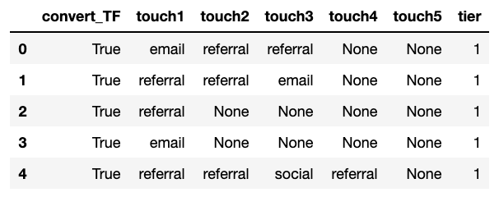
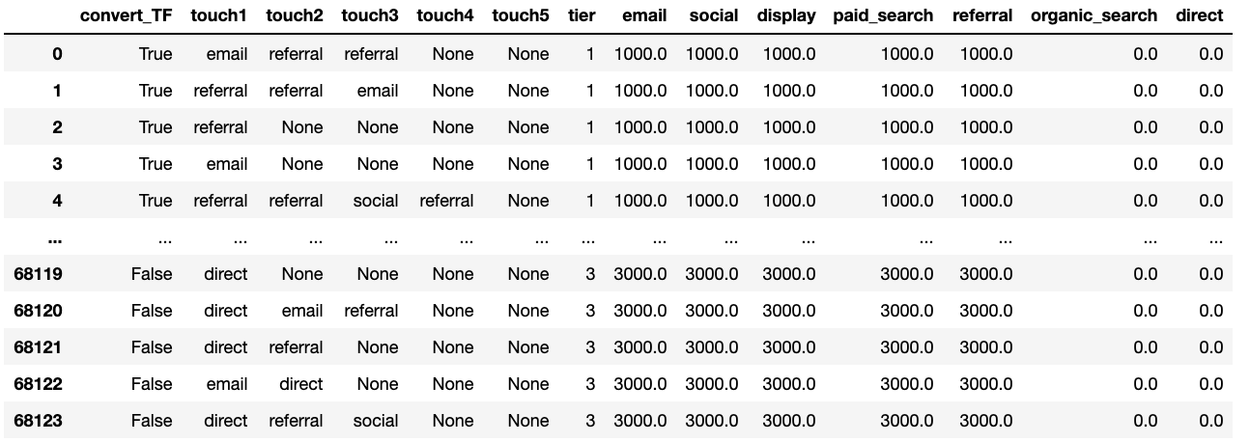
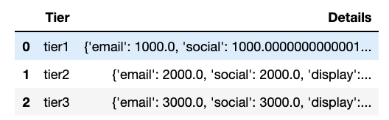
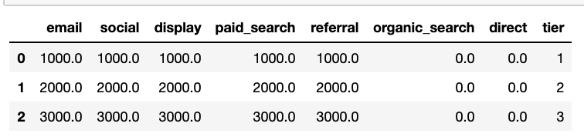
Data Preprocessing
To get an integrated version of data (68,124 rows x 14 columns)
Step 1: Fill NaN values
Step 3: Merge information to get a new dataframe
Step 2: Get current allocation details
Columns: 14 columns Row: 68,124 rows
Column: Convert_TF, touch 1-5, tier, email, social, display, paid_search, referral, organic_search, direct
Merge the two CSV files together. An integrated version of data.

Slide 3
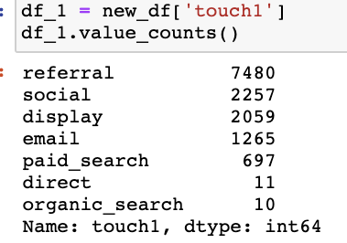
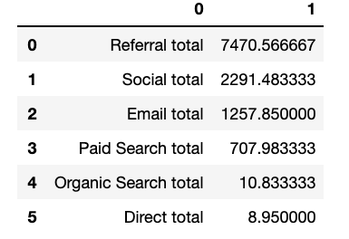
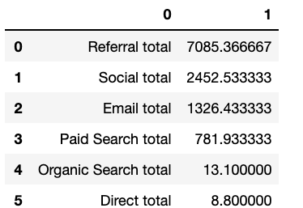
Methods: First Interaction + Linear + Position Based
3 Methods For Allocation
First Interaction
Linear
Position Based
First Touch
Last Touch
Touch = 2
50%
50%
Position Based
Touch >= 3
40%
20%
40%
First Touch
Others in total
Last Touch

Slide 4
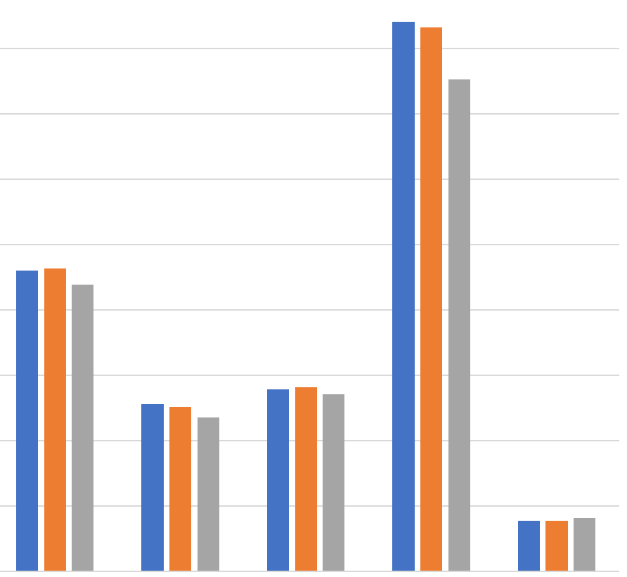
Allocation Summary
Discuss observations and potential conclusions from CAC calculations
Average CAC
Horizontal Comparison
The most effective way: Referral (has lowest CAC)
The least effective way: Paid Search (has highest CAC) Vertical Comparison
Channel: Email, Display, Social, Paid-Search
Observation: The CAC under linear method is higher than that under position-based method.
Since position-based method gives more credits on the 1st touch and the last touch → Those four touch methods appear more likely as either the 1st touch or the last touch.
Channel: Referral
Observation: the CAC under linear method is lower than that under position-based method
Since position-based method gives more credits on the 1st touch and the last touch → Referral appears more likely as touches in the middle.
9
8
7
6
5
4
3
2
1
0
Email | Social | Display | Paid Search | Referral

Slide 5
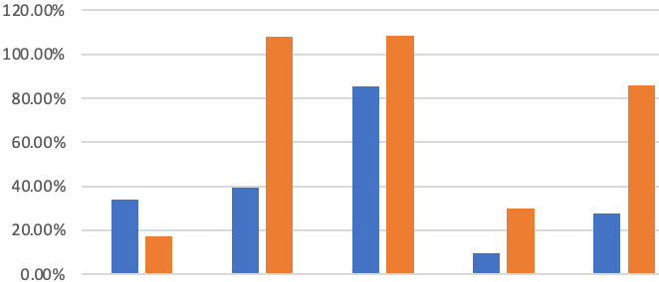
Allocation: Position-Based method and its marginal CAC
Position-based method
The most important factors affecting people's decision to buy the clothes are the first impression and the last touch. This is because that the first impression decides the baseline of buying desire while the last touch stimulates people’s emotion to buy.
Conclusion shift
Observation: If marketing scale increases, the marginal cost for referral touching method increases dramatically while that for email does not.
New Conclusion
As for large scale marketing strategy, referrals may not be the best touching method, but email touching seems to be the best.
Percent Change of Marginal Cost
Email | Social | Display | Paid Search | Referral

Slide 6
Allocation: New allocation with $11,000 budget
Email
Social
Display
Paid Search
Referral
Marginal
CAC
3.87
1.95
2.05
7.07
0.70
1,000
5.18
2.71
3.81
7.75
0.90
2,000
6.07
5.64
7.94
10.07
1.67
3,000
Conversion | Email | Social | Display | Paid Search | Referral
Spend 1000 | 258 | 513 | 487 | - | 1420
Spend 2000 | 193 | 369 | 263 | - | 1114
Spend 3000 | 165 | 177 | - | - | 599
Total | 616 | 1059 | 750 | 0 | 3132
Overall Conversion |  |  |  |  | 5557
According to marginal CAC, we plan to spend $3000 on email, $3000 on social, $2000 on display,
$0 on paid search and $3000 on referral. 5557 customers are predicted to be converted.

Slide 7

THANKS FOR LISTENING

